Slide 1

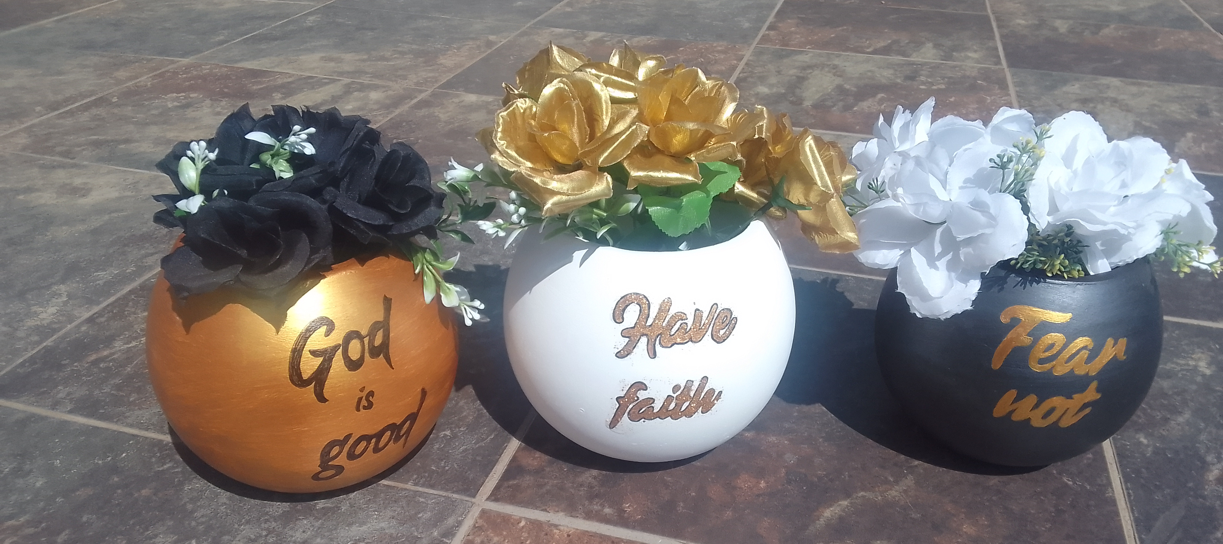






Home
About
Gallery
Custom
Shop
Contact
Custom Creations for Every Occasion
Brows Gallery
Order Custom Piece
At Clay Station 7, we bring your creative visions to life with handcrafted decorative cement art. Each piece is custom-made, ensuring that your special occasions are adorned with unique, personalized touches.

Slide 2
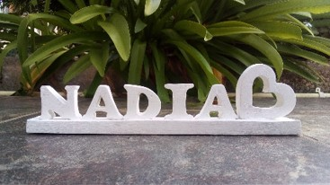
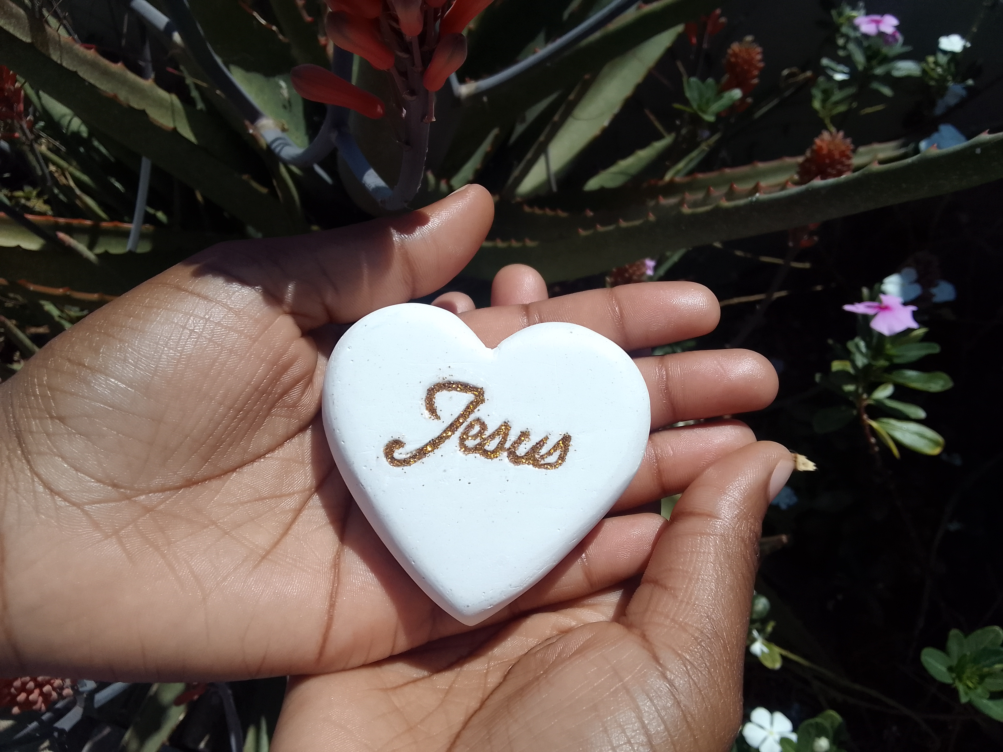
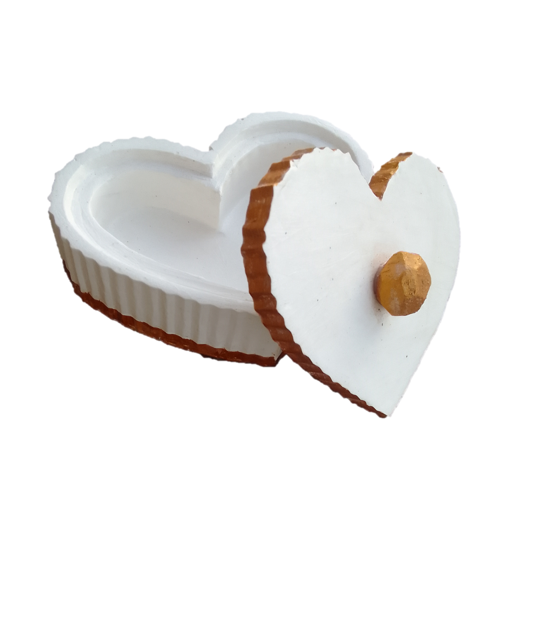
Customer Testimonials
My desk has never looked more beautiful with my custom name stand by ClayStation7
~ Nadia Pieters
This cement art reminds me that Jesus is my firm foundation.
~ Ebby
I really appreciate the ClayStation7 team for making this beautiful and unique jewelry
~ Cindy Dongua
Address: "123 Art Lane, Creative City, 56789 © 2024 Clay Station 7. All rights reserved.

Slide 3
Home
About
Gallery
Custom
Shop
Contact
Our Story
Clay Station 7 was founded in 2022 with a passion for art and craftsmanship. Our journey began with a simple idea – to turn cement, a basic construction material, into something extraordinary. Today, we continue to push the boundaries of creativity, delivering custom art pieces that capture the essence of every occasion
The Creative Process
Each piece of art is handcrafted with precision and care. From the initial concept to the final product, our team works closely with clients to ensure their vision is brought to life. Our process involves selecting the finest materials, crafting the design, and finishing with expert detailing.

Slide 4
Meet the team
Founder and Artist
Address: "123 Art Lane, Creative City, 56789 © 2024 Clay Station 7. All rights reserved.

